Slide 1
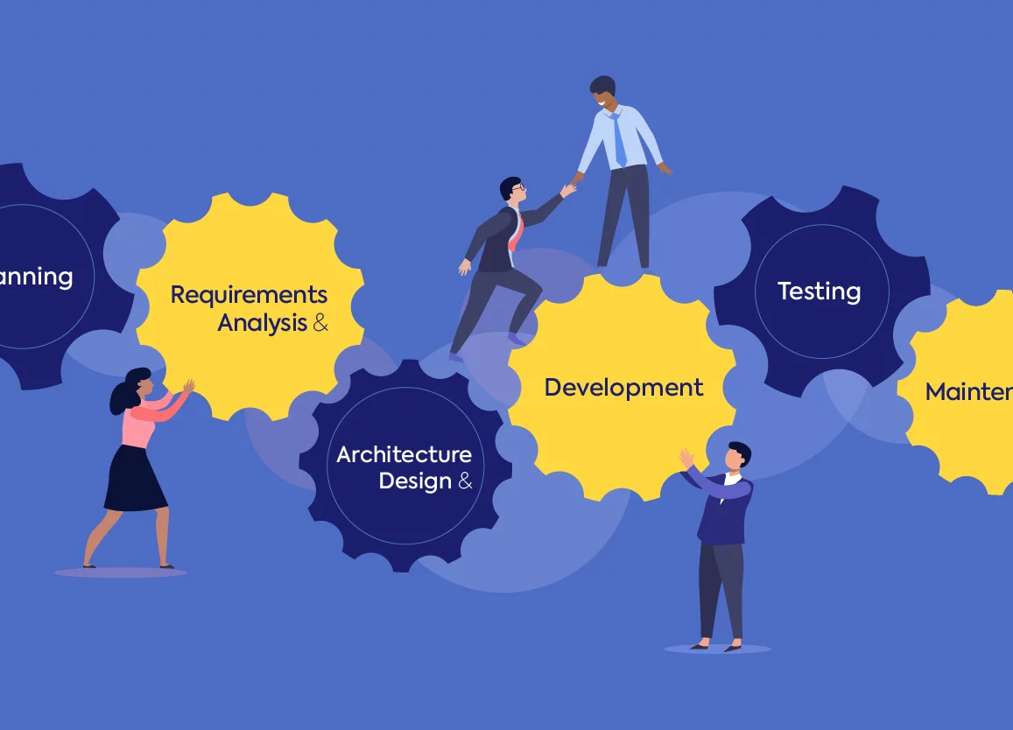
Azure DevOps
Plugin
DORA Metrics
Adfolks LLC

Slide 2
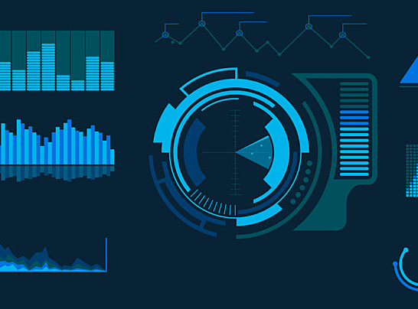
Dashboards

Slide 3
DORA Metrics
Fully configurable Azure DevOps dashboard plugin for DORA metrics.
Deployment Frequency
Lead Time for Changes
0.9
48 Hours
Per Day
High
High
Mean time to recover
Change failure rate
14 Hours
5%
Elite
High
Notes:
The agile values are not rules.
What they are is a way of thinking, a set of values and beliefs that help encourage creativity, make product and software development more effective and reactive, and allow teams to respond faster and more directly to what their customers actually need and want.

Slide 4
DORA Metrics
Deployment Frequency
Lead Time for Changes
Deployment Frequency: 0.9 per day (Last 30 days)
Deployment Frequency ranking: High
Average lead time for changes: 48 hours (Last 30 days)
Average lead time for changes ranking: High
Mean Time to Recover
Average Mean Time to Recover: 14 hours (Last 30 days)
Average Mean Time to Recover ranking: High
Notes:
The agile values are not rules.
What they are is a way of thinking, a set of values and beliefs that help encourage creativity, make product and software development more effective and reactive, and allow teams to respond faster and more directly to what their customers actually need and want.

Slide 5

KPIs

Slide 6
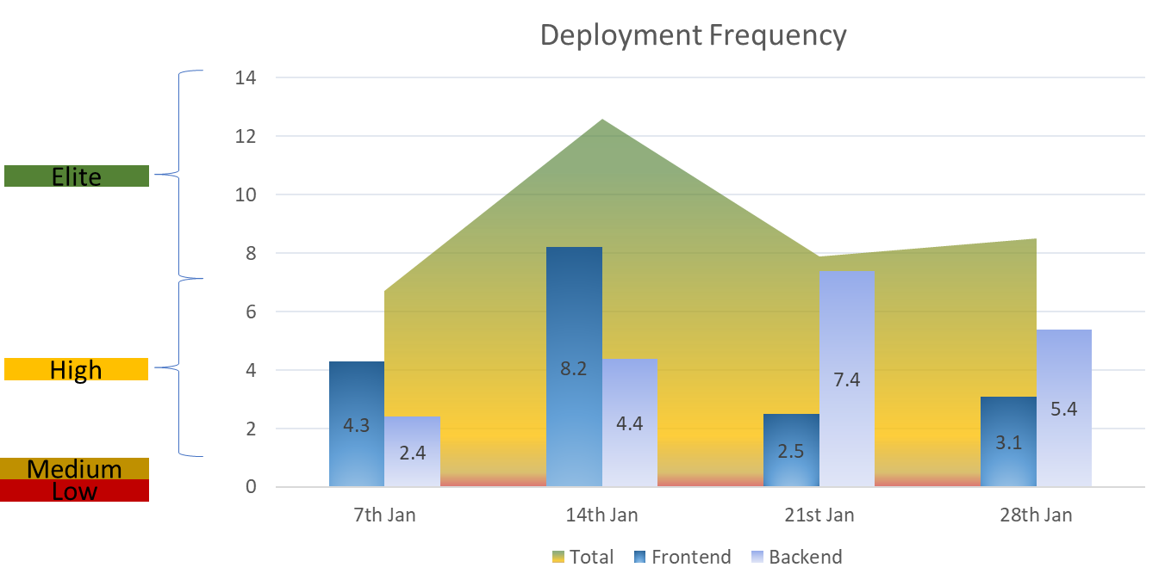
Deployment Frequency
How often an organization successfully releases to production. We look at the number of successful pipeline runs.
Calculation:
Weekly : {number of deployments} / 7
Monthly : {number of deployments} / 30
DF (based on monthly values) | Ranking
> 1 | Elite
< 1 & > 0.14 | High
< 0.14 & >0.03 | Medium
< 0.03 | Low
Note: We can add the DF for different environments like Dev, UAT, Prod etc. instead of frontend and backend to view them in comparison.
Deployment Frequency: 1.21 per day (Last 7 days)
Deployment Frequency ranking: Elite
Notes:
The agile values are not rules.
What they are is a way of thinking, a set of values and beliefs that help encourage creativity, make product and software development more effective and reactive, and allow teams to respond faster and more directly to what their customers actually need and want.

Slide 7
Deployment Frequency
Deployment Frequency: 0.9 per day (Last 30 days)
Deployment Frequency ranking: High
Deployment Frequency
0.9
Notes:
The agile values are not rules.
What they are is a way of thinking, a set of values and beliefs that help encourage creativity, make product and software development more effective and reactive, and allow teams to respond faster and more directly to what their customers actually need and want.

Slide 8
Lead Time for Changes
Time it takes to go from code committed to code successfully running in production. The solution is based on calculating the difference between the earliest commit timestamp in a change batch (that lead to a deployment) with the timestamp of the actual deployment in production.
Calculation:
Sum of (deployment time – first code commit time for the deployment ) / total deployments in week/month
LTC (days) | Ranking
< 1 | Elite
> 1 & < 7 | High
> 7 & < 30 | Medium
> 30 | Low
Average lead time for changes: 48 hours (Last 30 days)
Average lead time for changes ranking: High
Lead Time for Changes
48 hours
Notes:
The agile values are not rules.
What they are is a way of thinking, a set of values and beliefs that help encourage creativity, make product and software development more effective and reactive, and allow teams to respond faster and more directly to what their customers actually need and want.

Slide 9
Change Failure Rate
The percentage of deployments causing a failure in production. the percentage of changes that were made to a code that then resulted in incidents, rollbacks, or any type of production failure.
Calculation:
(Number of deployment failures / total deployments in week/month) * 100
CFR | Ranking
0-15 % | Elite
16-30 % | High
31-45 % | Medium
46-60 % | Low
Change failure rate: 5% (last 30 days)
Change failure rate ranking: Elite
Change failure rate
5%
Notes:
The agile values are not rules.
What they are is a way of thinking, a set of values and beliefs that help encourage creativity, make product and software development more effective and reactive, and allow teams to respond faster and more directly to what their customers actually need and want.

Slide 10
Mean Time to Recover
The Mean Time to Recover metric measures the time it takes for a service to bounce back from a failure.
Calculation:
{Sum of (Time of incident from start to being resolved)} / {Total incident count in week/month}
Average Mean Time to Recover: 14 hours (Last 30 days)
Average Mean Time to Recover ranking: High
MTR | Ranking
< 1 hour | Elite
< 24 hours | High
< 1 week | Medium
< 1 month | Low
Mean time to recover
14 hours
Notes:
The agile values are not rules.
What they are is a way of thinking, a set of values and beliefs that help encourage creativity, make product and software development more effective and reactive, and allow teams to respond faster and more directly to what their customers actually need and want.

